Slide 1
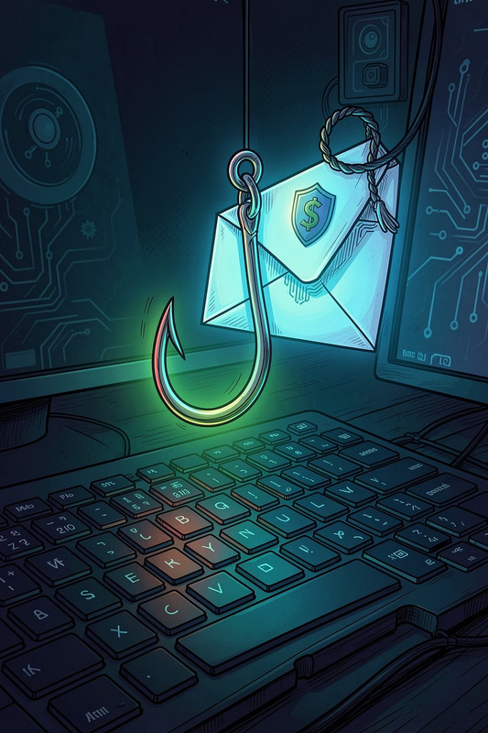
The Phishing Trap: Don't Take the Bait
Everyyear,millionsfall victimtophishingattacks.This modulewillequip
youwiththeknowledge torecognize,resist,andreport them.
CYBERSECURITY AWARENESS
INTERACTIVE MODULE

Slide 2
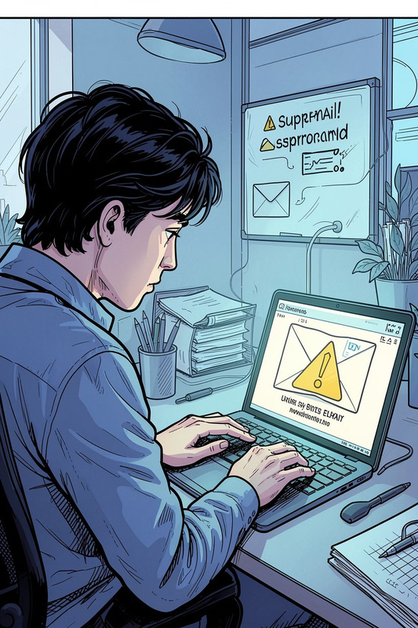
Understanding the Threat
What is Phishing?
Attack Vectors
Impersonatingtrusted entities to steal credentials or install malware.
Beyond email:Smishing (SMS)
and Vishing (voice calls) are equally dangerous.
The High Stakes
Identitytheft,financial loss, and compromised organizational security.

Slide 3
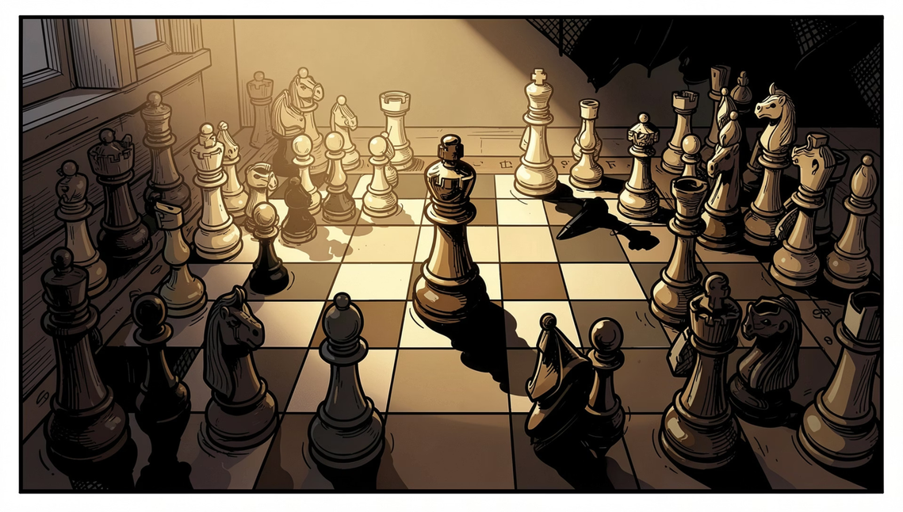
The Art of Social Engineering
Phishing is not random — it is psychological warfare. Attackers exploit human instincts to bypass your defenses.
Emotional Manipulation
Personalization
The Illusion of Trust
Artificial urgency or fear short- circuits critical thinking.
Attackers mine social media for Spear Phishing — highly targeted attacks using your name, role, and habits.
Official logos and familiar branding lower your guard instantly.

Slide 4
Anatomy of a Phishing Email
Every phishing email leaves traces. Learn to spot the warning signs before you click.
Linguistic Red Flags
The Urgency Trap
Grammar errors and an odd tone.
Threatsofsuspensionor
legal action.
Sender Discrepancy
Malicious Payload
Displayname masksa suspicious address.
Linksor attachmentsmeant
to steal data.
Always inspect the full sender address, not just the display name. A message from "PayPal Support" could originate from
support@paypa1-secure.xyz.

Slide 5
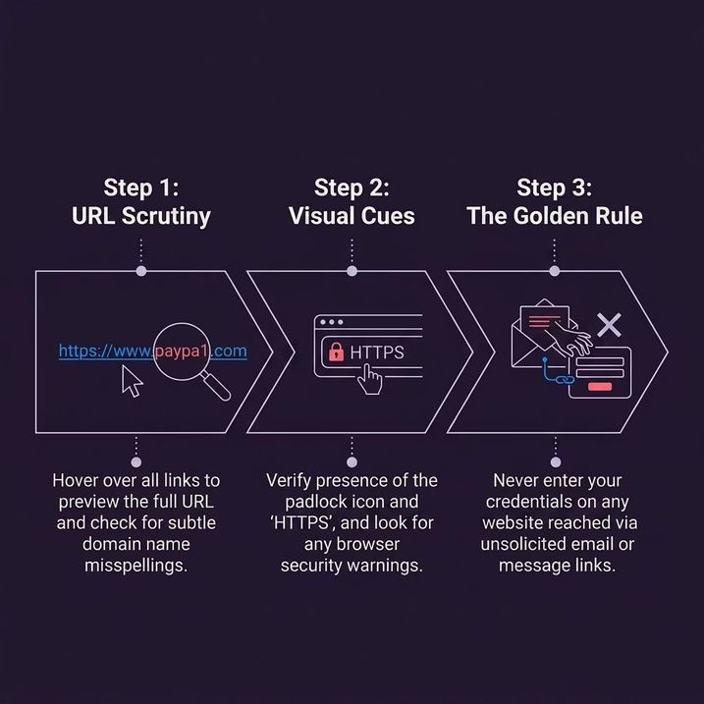
Fake Websites: The Digital Deception
Why Fake Sites Fool Us
Modernphishing sitesarenear-perfect replicas. Attackers
clone login pages to harvest credentials in seconds.
Key rule: If you arrived via an unsolicited link, do not enter any credentials — navigate directly to the official site instead.

Slide 6
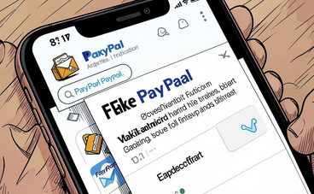
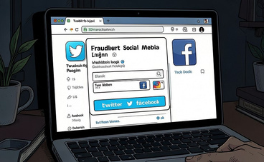
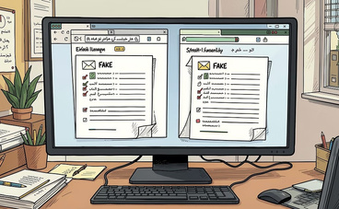
Real-World Case Studies
Corporate Impersonation
Clone Phishing
replacing attachments with malicious versions — familiarity breeds trust.
Social Media Scams
Fraudulent login pages onfake
Twitter/Facebook sites harvested
thousands of credentials.
A fakePayPal invoice prompted a finance employee to " dispute a charge," leading to credential theft.
Attackers replicatelegitimate emails,

Slide 7
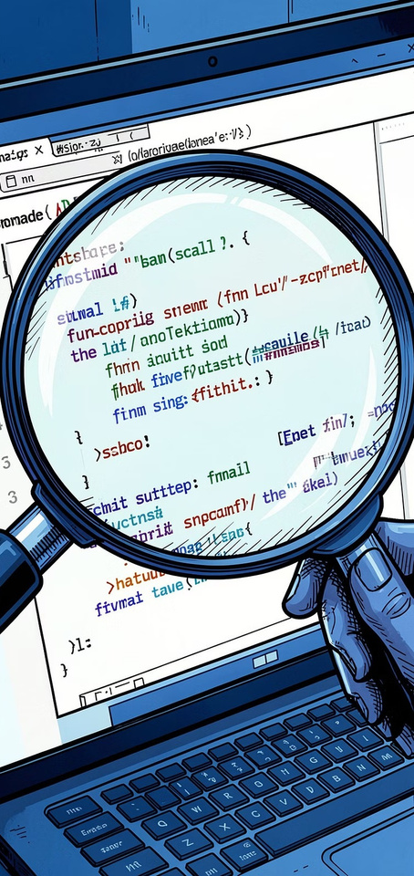
Interactive Quiz: Spot the Scam
Test your instincts. For each challenge, decide: legitimate or malicious?
1
2
Challenge 1: Email Header
Challenge 2: Link Preview
A message from "IT Support" shows sender
admin@yourcompany-
security.xyz. Spot the
inconsistency.
A "Reset Password" button hides bit.ly/3xK9mP. What's the risk?
3
Challenge 3: Urgent Request
"Your account will be suspended in 2 hours — click here." What do you do?
Answers: 1 — Domain doesn't match company. 2 — Shortened URLs hide destinations. 3 — Navigate directly to the official site; never click unsolicited links.

Slide 8
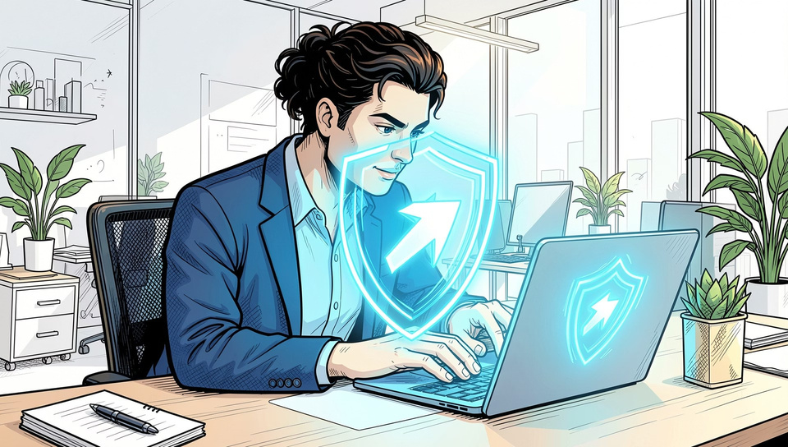
Best Practices: Your Defensive Toolkit
Verify First
Contact organizations through official channels — never use links provided in suspicious messages.
Technical Layers
Keepbrowsers, OS,and antivirus
updated. Enable multi-factor authentication everywhere.
Digital Hygiene
Treat unexpectedattachments and
pop-ups as suspicious by default. When in doubt, delete.

Slide 9
Building a Culture of Vigilance
Security is a team sport. Empower everyone to become a human firewall.
Report It
Own It
Check It
Alert your IT department immediately when you spot suspicious activity.
Move from potential victim to active protector. Share what you learn.
Before every click: verify sender, inspect links, question urgency, check URLs, trust your instincts.

Slide 10
Stay One Step Ahead
New threatsevolveconstantly,butthe corepsychological tactics remain
the same. Awareness is your strongest defense.
Remember
Commit
Urgency, fear, and familiarity are attacker tools — pause before reacting.
Adopt the Verify First rule for every unsolicited request.
Act
Report, educate, and protect. Your vigilance safeguards everyone.

